Slide 1
Section K
Lipid Metabolism
Guodong Yang
Biochemistry and Molecular Biology, College of Life Sciences
gdyang@sdau.edu.cn
13854808762

Slide 2

1g葡萄糖释放约16KJ的能量
1g脂肪可以放出约39KJ的能量。

Slide 3
K1 Structures and roles of fatty acids
K2 Fatty Acid Breakdown
K3 Fatty Acid Synthesis
K4 Metabolism of Triacylglycerols

Slide 4
K1
Structures and roles
of fatty acids

Slide 5
1. Lipid
Biological lipids are a chemically diverse group of compounds, the common and defining feature of which is their insolubility in water.
Fats and oils (storage lipids)
Phospholipids and sterol (major elements of membranes)

Slide 6
生物体内的脂类(lipid)
（脂质，类脂）：脂肪酸和醇组成或其衍生物
三酰甘油
单纯脂类
蜡
皂化脂类
磷脂
复合脂类
糖脂
硫脂
萜 类
非皂化脂类
类固醇

Slide 7
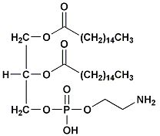
The fats and oils used almost universally as stored forms of energy in living organisms are derivatives of fatty acids.
Typical type of fatty acid-containing compounds are triacylglycerols.
(C4 to C36)

Slide 8
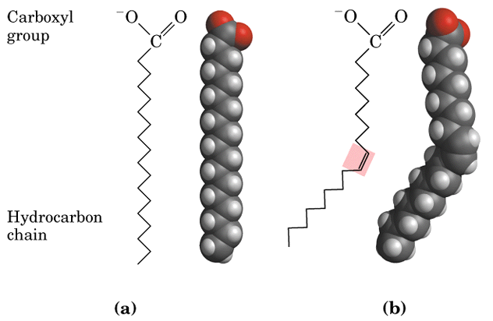
2. Structure and properties of Fatty acids

Slide 9
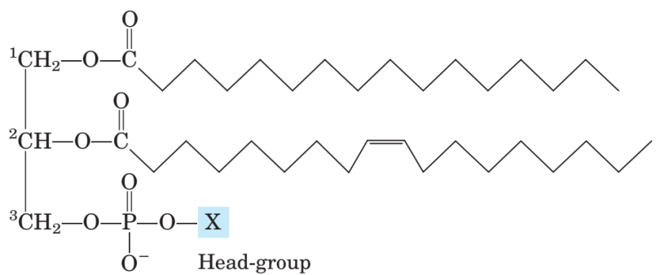
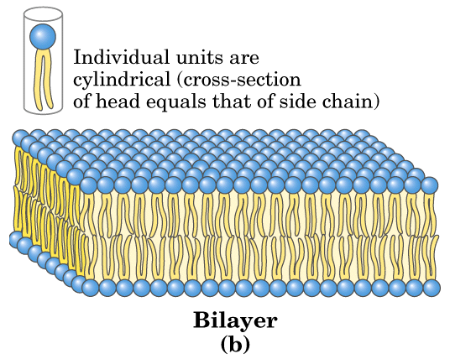
Cell membrane

Slide 10
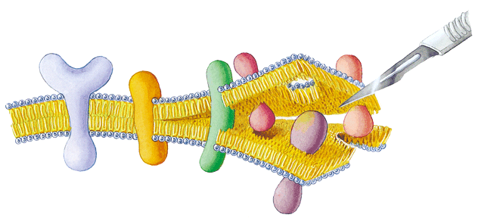

Slide 11
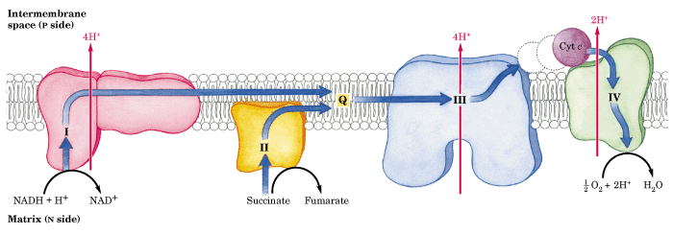
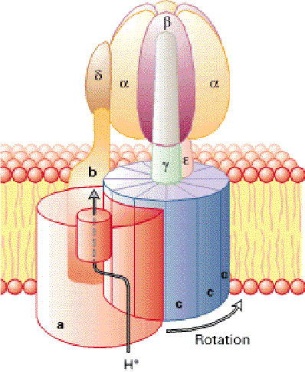

Slide 12
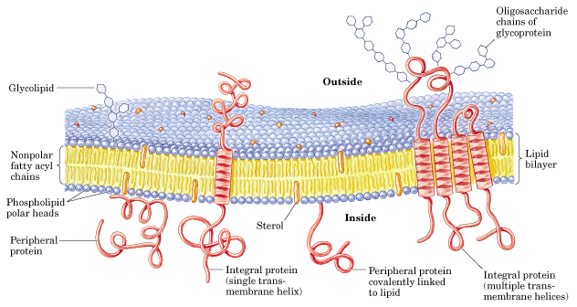
Notes:
12

Slide 13
Membranes consist mainly of lipids and proteins with mass ratio ranges between 1:4 to 4:1 (membranes with different functions have different proteins, some lipids and proteins have covalently linked carbohydrates).
1.2.1 In membranes the three major classes of lipids are the glycerophospholipids (甘油磷脂）, the sphingolipids （鞘磷脂） and the sterols（固醇）.

Slide 14
The glycerophospholipids (甘油磷脂）have a glycerol backbone that is attached to two fatty acid hydrocarbon chains and a phosphorylated head group.
These include：
phosphatidate (磷脂酸）
phosphatidylcholine （磷脂酰胆碱）
phosphatidylethanolamine （磷脂酰胆胺）
phosphatidylglycerol （磷脂酰甘油）
phosphatidylinositol（磷脂酰肌醇）
diphosphatidylglycerol （二磷脂酰甘油，心磷脂）

Slide 15
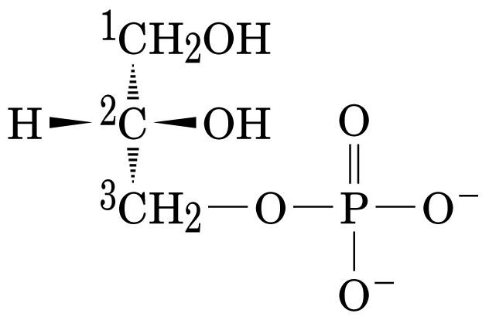
H
glycerol

Slide 16
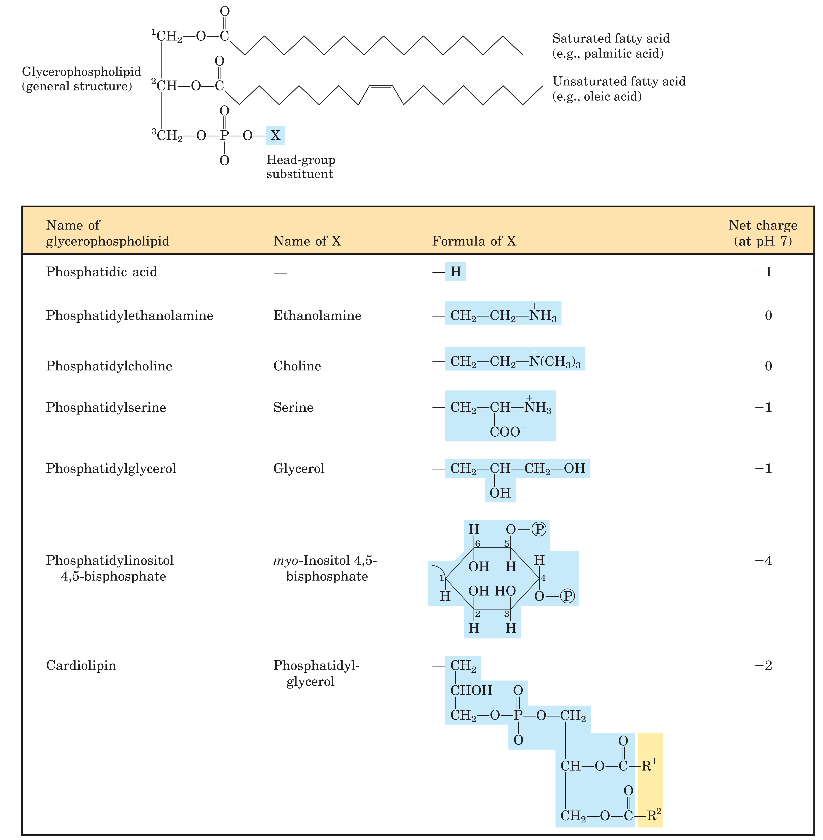
phosphatidate (磷脂酸）
phosphatidylethanolamine （磷脂酰胆胺）
phosphatidylcholine （磷脂酰胆碱）
phosphatidylglycerol （磷脂酰甘油）
phosphatidylinositol（磷脂酰肌醇）
diphosphatidylglycerl （二磷脂酰甘油）
心磷脂

Slide 17
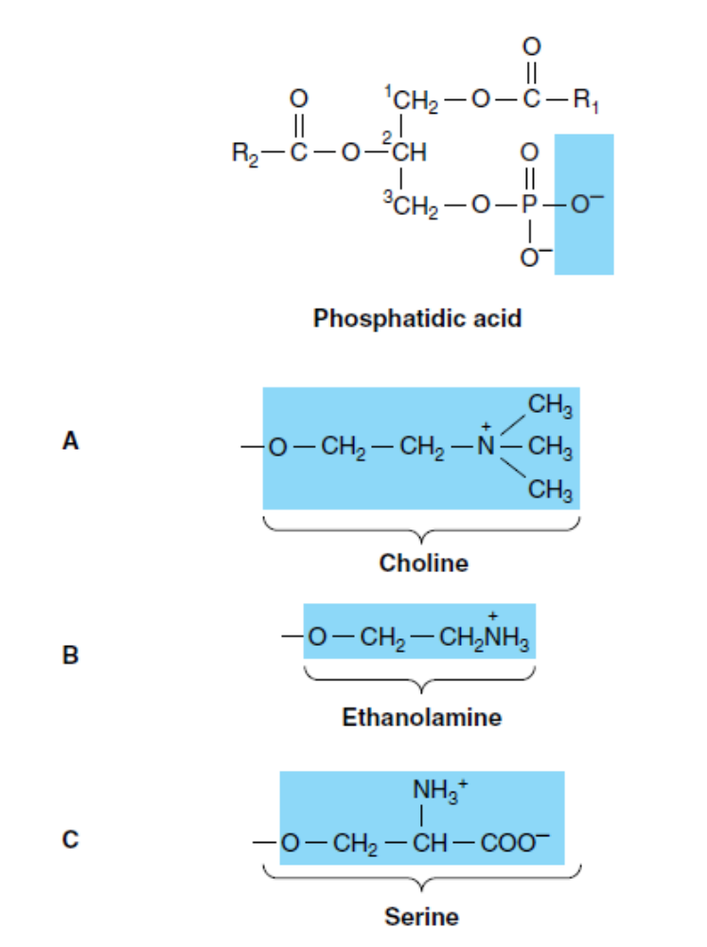
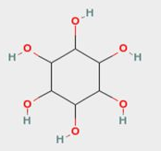
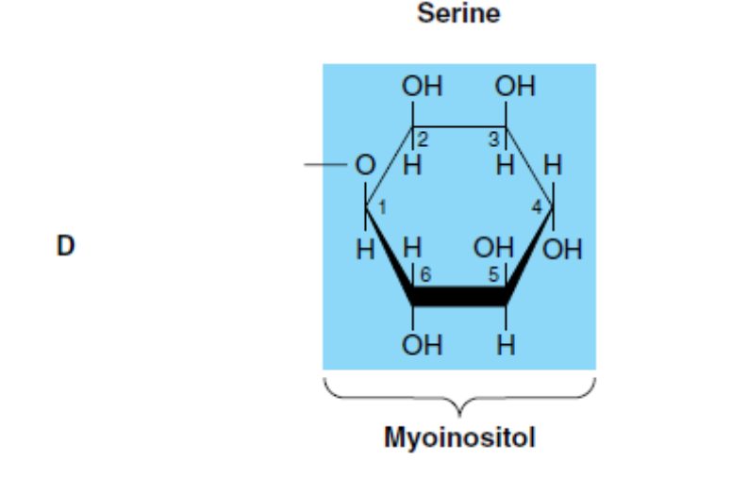
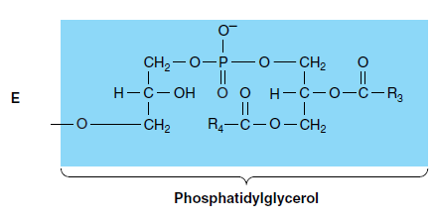

Slide 18
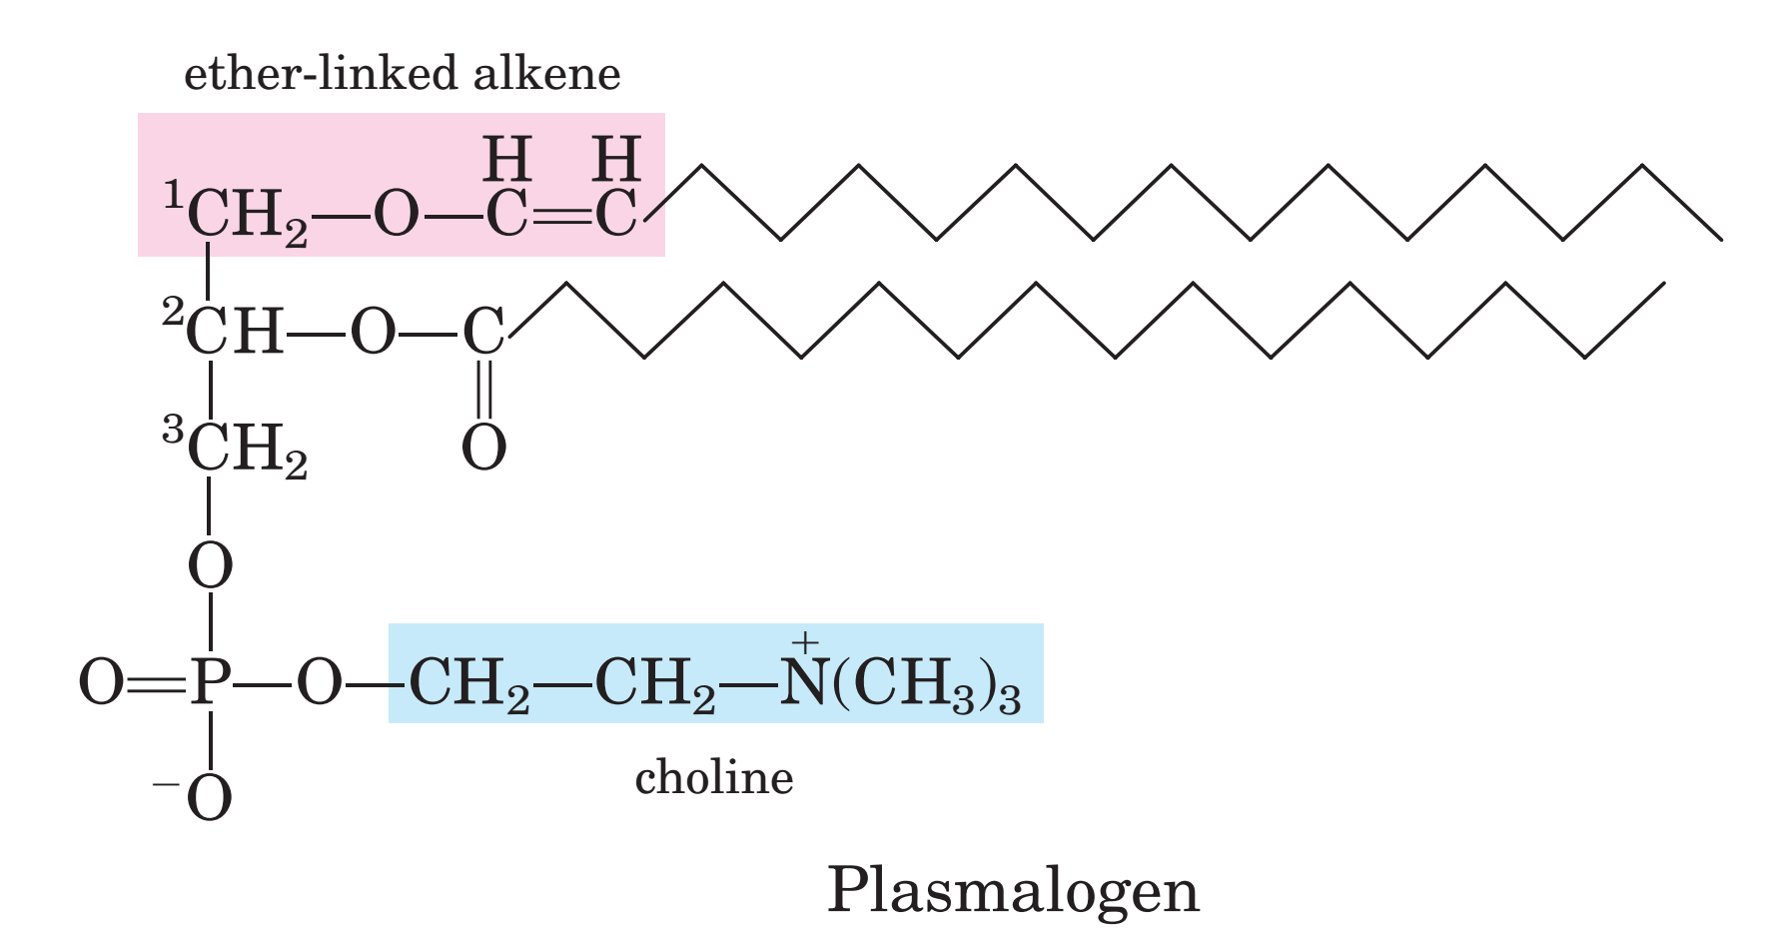

Slide 19
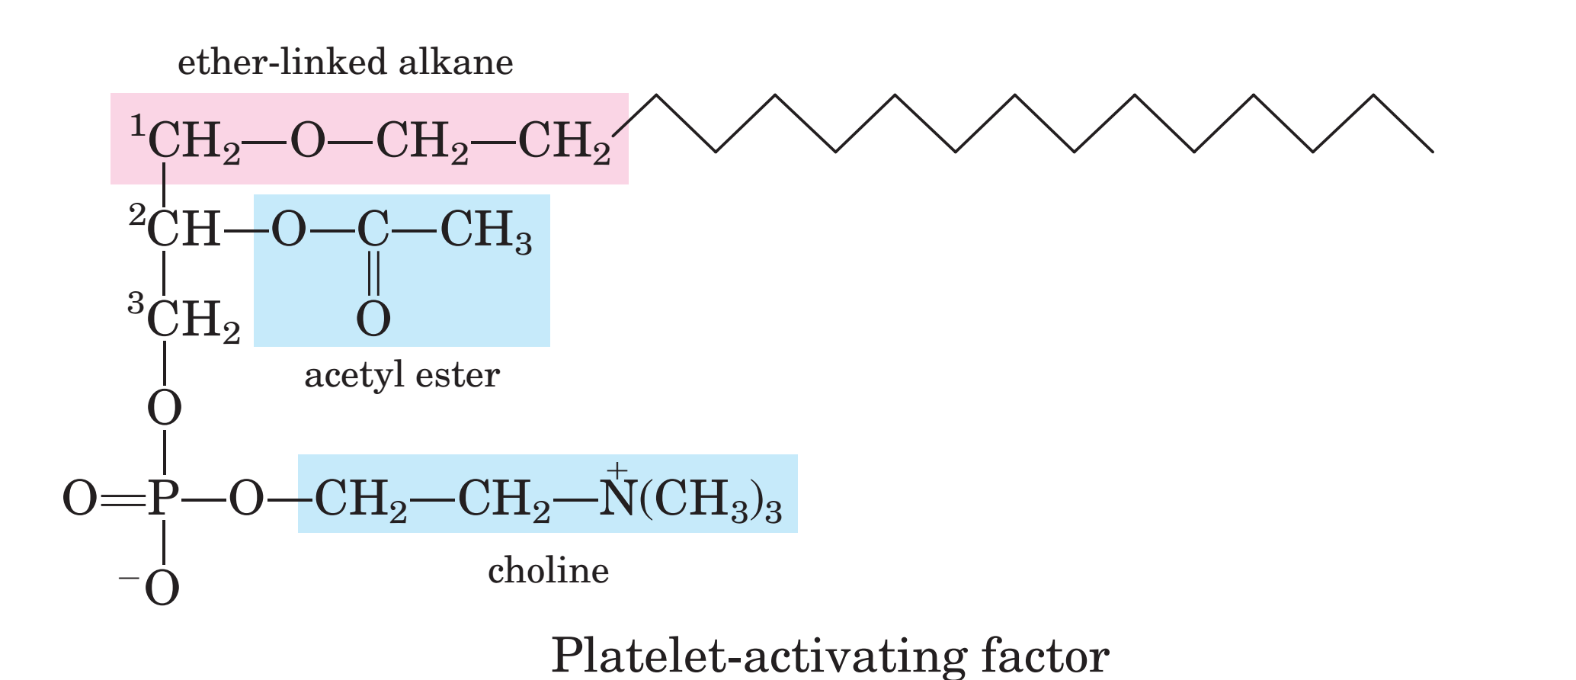

Slide 20
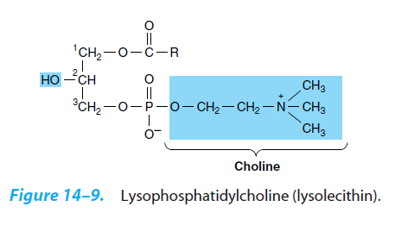

Slide 21
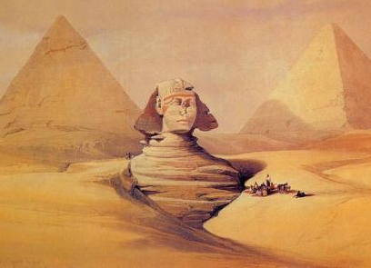
(2) The sphingolipids （鞘氨醇磷脂类） are base on sphingosine （鞘氨醇）to which a single fatty acid chain is attached and either a phosphorylated head group (sphingomyelin) or one or more sugar residues.
Sphinx

Slide 22
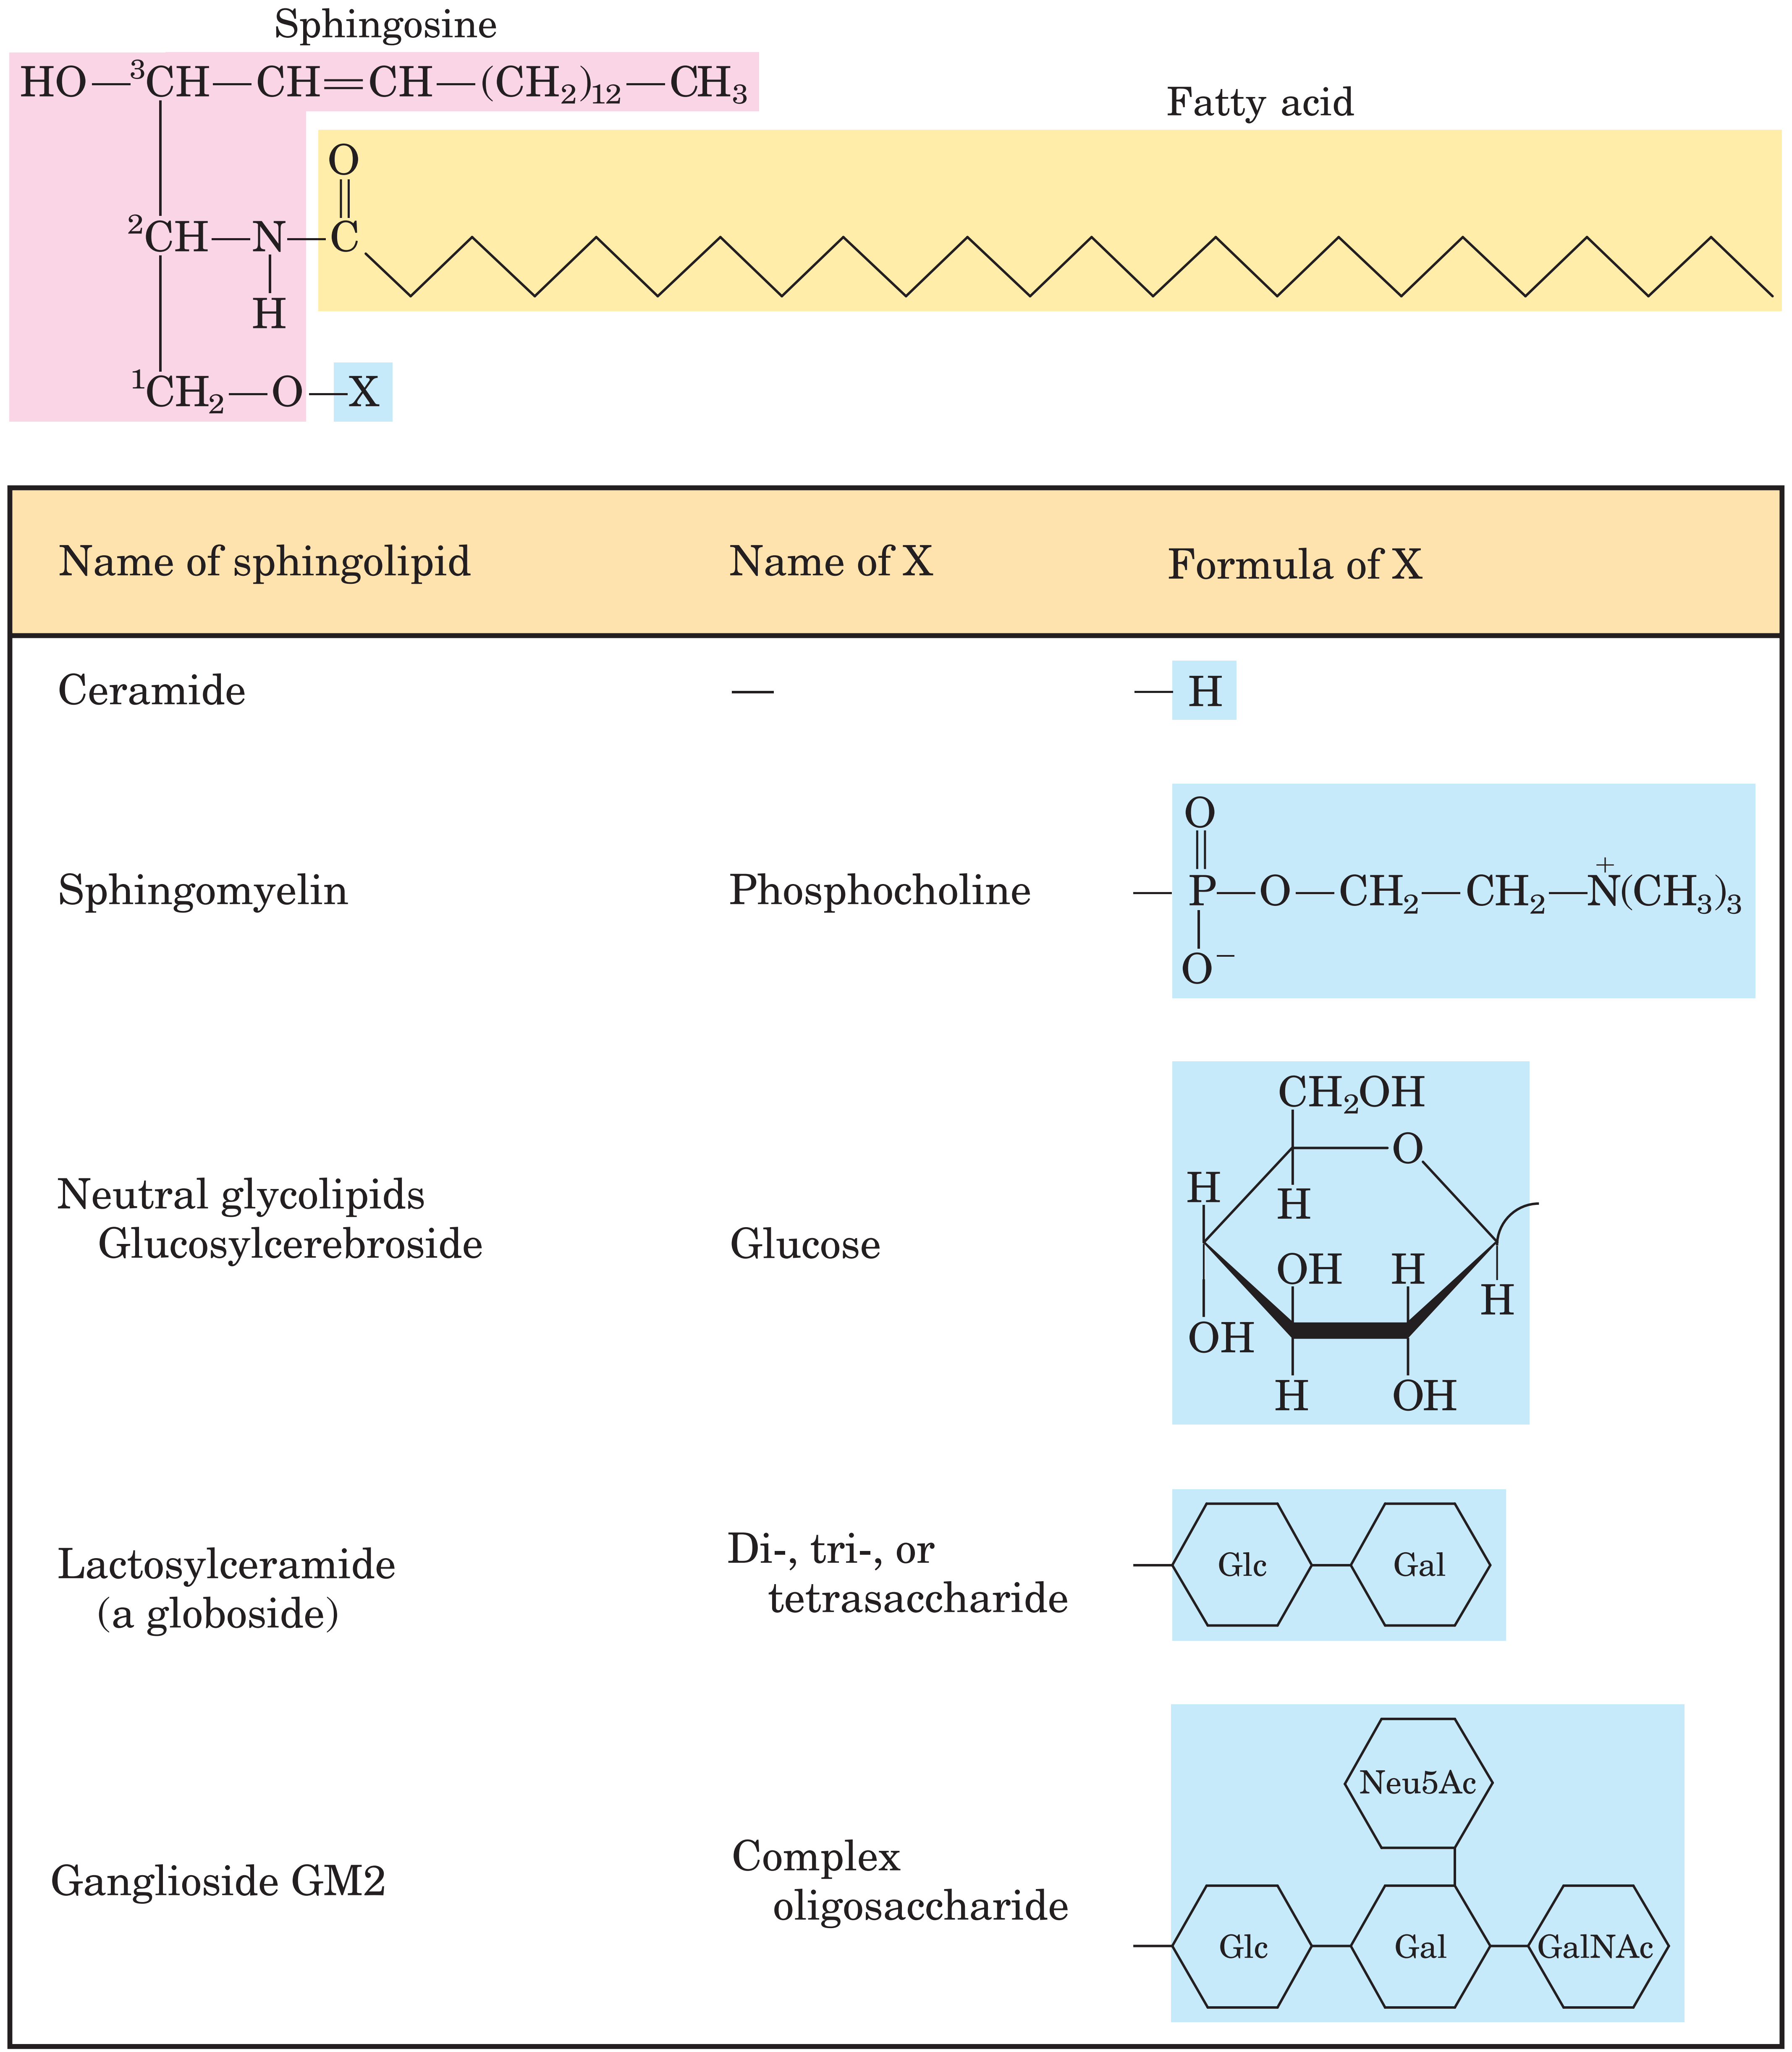
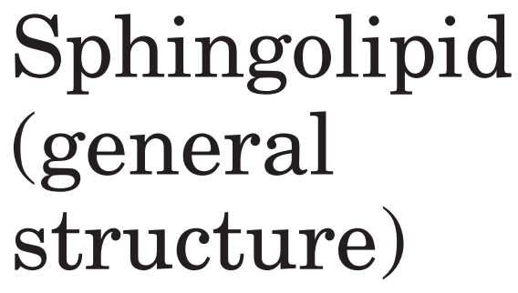

Slide 23
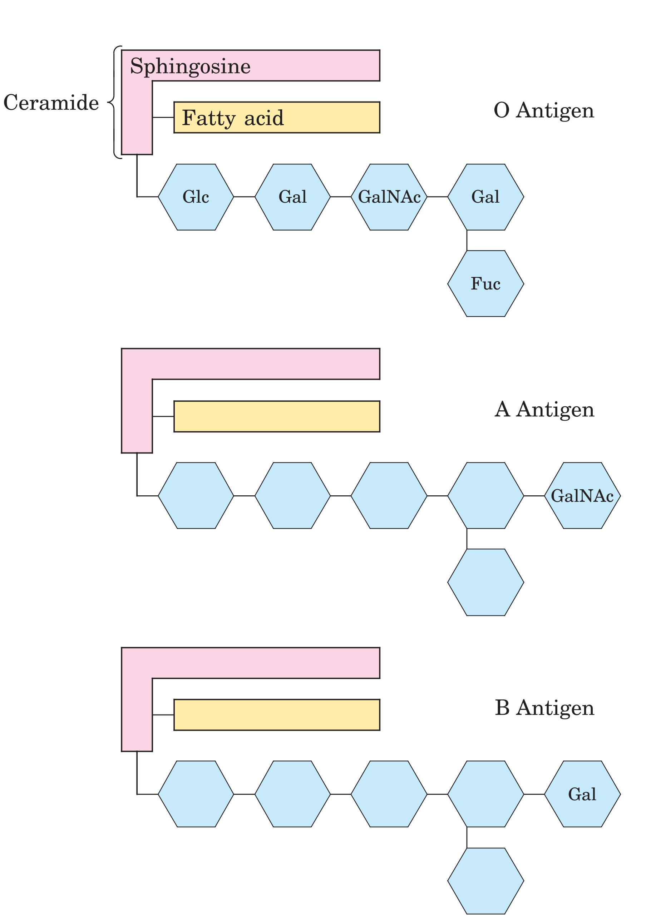
Ceramide
神经酰氨
Glycosphingolipids
as determinants of blood
groups.

Slide 24
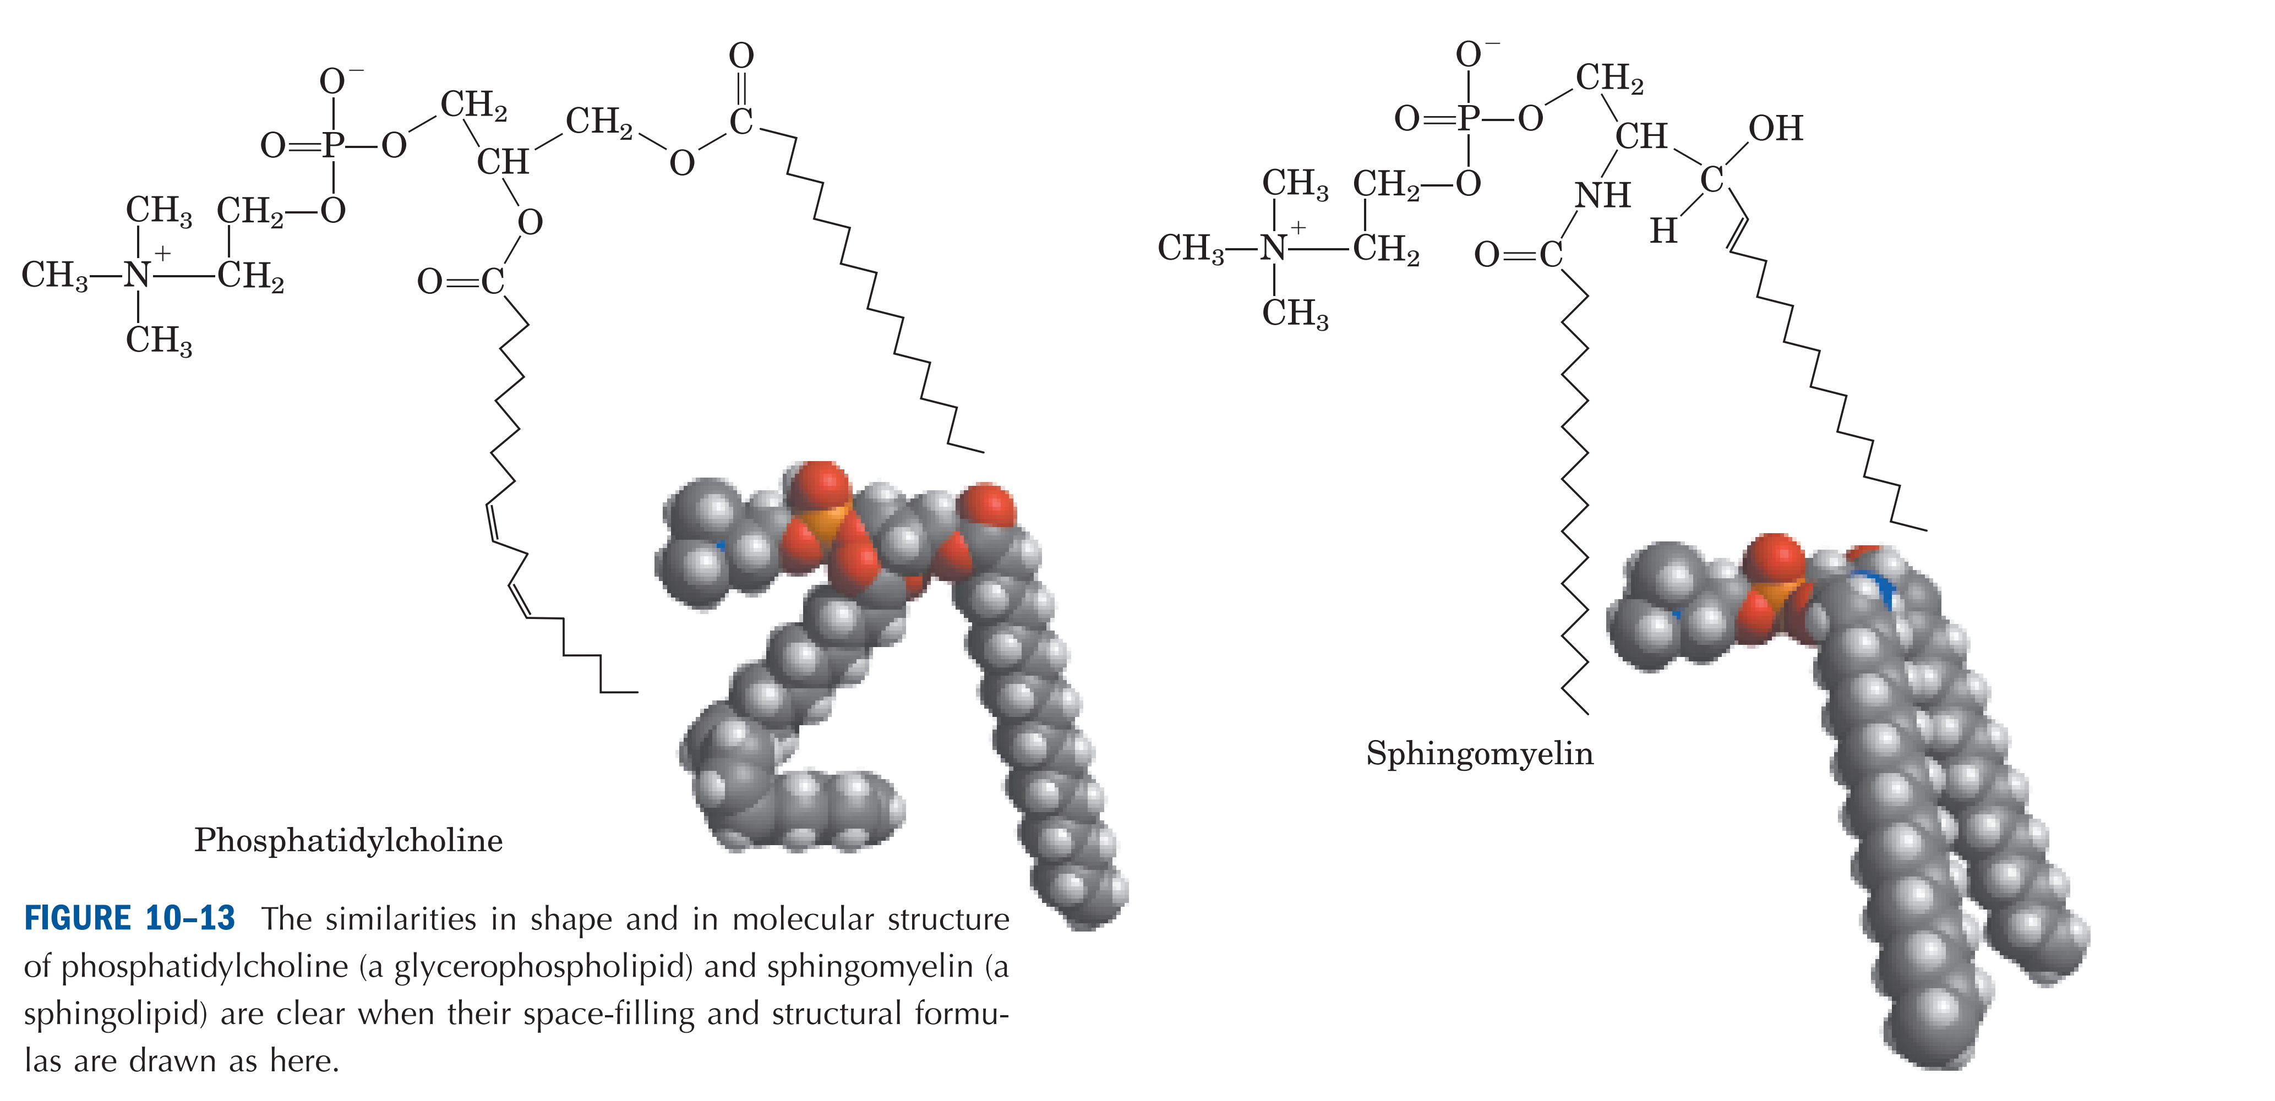

Slide 25
(3) The major sterol (固醇） in animal plasma membranes is cholesterol （胆固醇）, while the structurally related stigmasterol (豆甾醇） and β–sitosterol（谷甾醇） are found in plants.

Slide 26
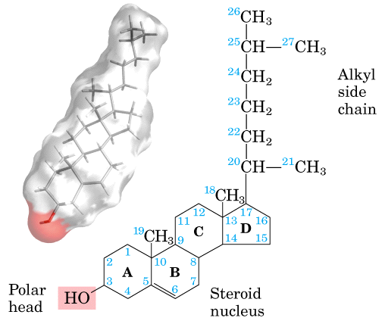
胆固醇
Sterols Have Four Fused Carbon Rings

Slide 27
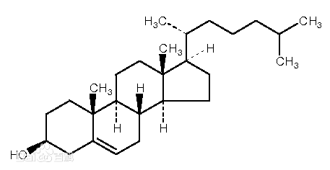
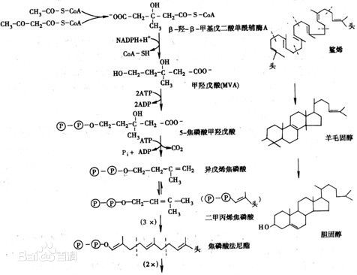
胆固醇

Slide 28
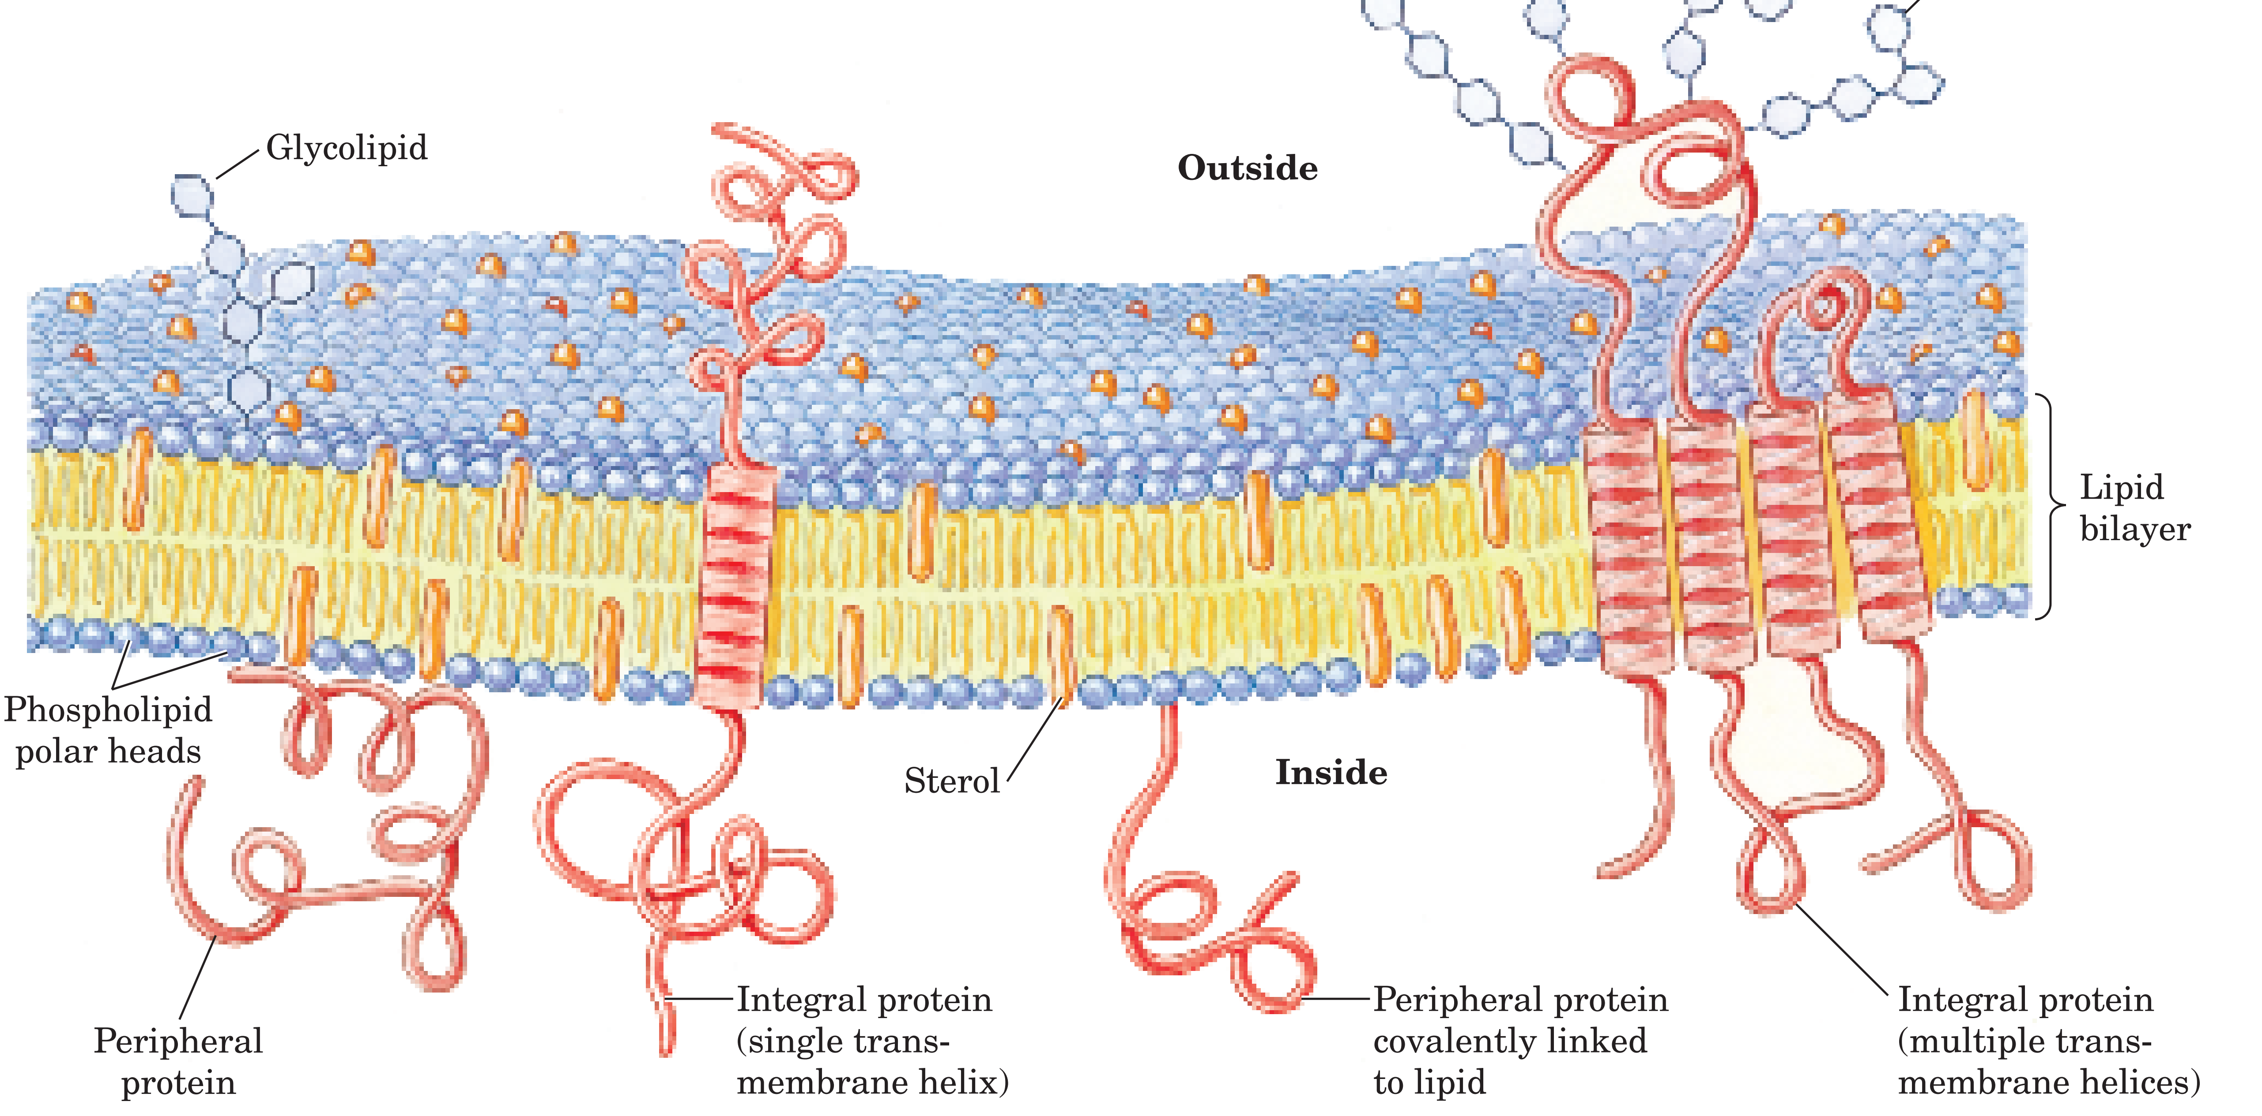

Slide 29
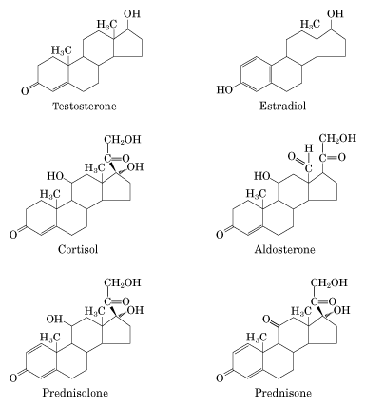
雌二醇
睾丸素
醛甾酮
皮质（甾）醇

Slide 30
Prostaglandins (前列腺素）
前列腺素（PG）实际上是一类具有生物活性的物质的总称，目前已发现的有几十种，它的基本结构为含一个环戊烷及两个脂肪侧链的二十碳脂肪酸，即前列腺烷酸。
由于环戊烷上的不饱和键位置或取代基不同，可将已知的前列素分为E、F、A、B 四大类。

Slide 31
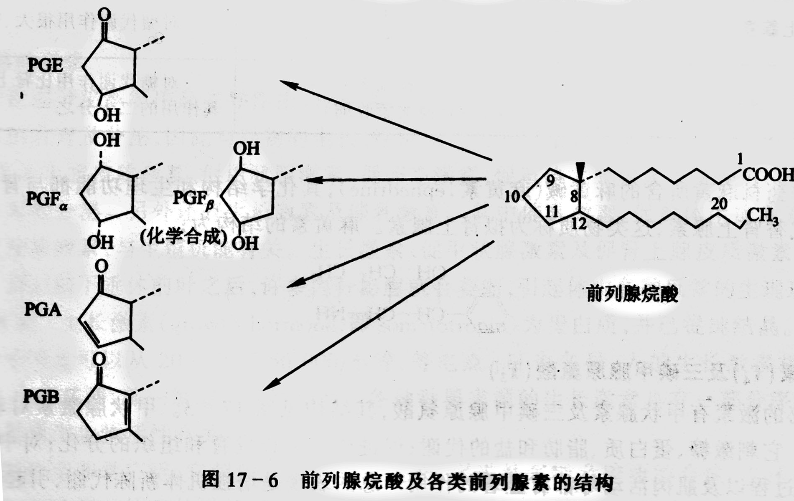

Slide 32
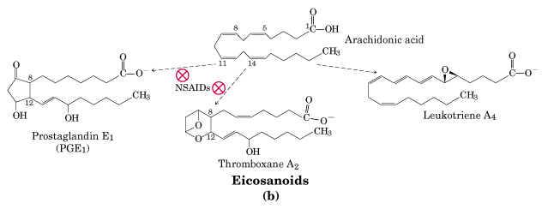
凝血噁烷

Slide 33
3. Nomenclature
Fatty acids are named according to the number of carbon atoms in the chain and the number and position of any double bonds.
Palmitate (C16:0) 棕榈酸（软脂酸）
Stearate (C18:0) 硬脂酸
Oleate (C18:1（Δ⁹）） 油酸
Linoleate (C18:2（Δ^{9,12}）） 亚油酸
Linolenate (C18:3) 亚麻酸
Arachidonate (C20:4) 花生四稀酸

Slide 34
4. Roles
Energy stores (triacylglycerols) and fuel molecule
Components of membranes (glycerophospholipids and sphingolipids)
As hormones and intracellular second messengers (DAG, diacylglycerol)
Covalently joined with some proteins

Slide 35
Fatty Acid Breakdown (K2)

Slide 36
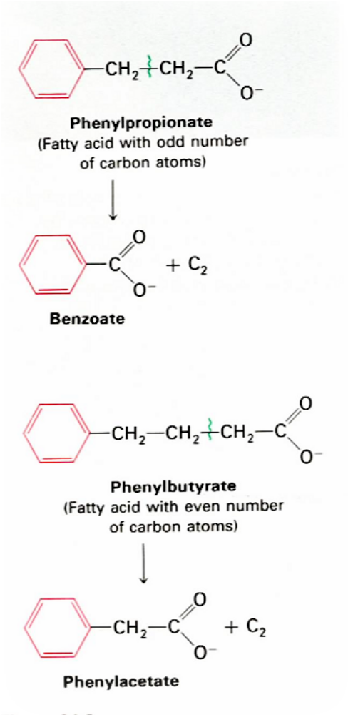
1. Early labeling experiments (1904): fatty acids are degraded by sequential removal of two-carbon units
When dogs were fed with odd-numbered fatty acids attached to a phenyl group, benzoate was excreted; and when fed with even-numbered, phenylacetate was excreted.
Hypothesis: the β-carbon is oxidized,with two-carbon units released by each round of oxidation.

Slide 37
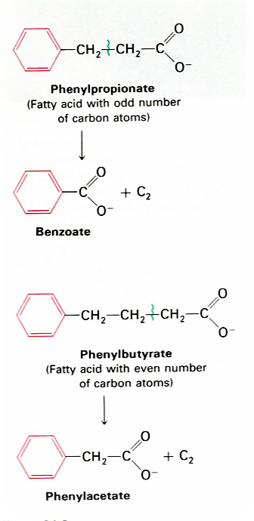
β
α
Franz Knoop’s labeling
Experiments (1904):
fatty acids are degraded
by oxidation at the β
carbon, i.e., β oxidation.
β
α

Slide 38
These experiments are a landmark in biochemistry, in using synthetic label (the phenyl group here) to elucidate reaction mechanism, and was done long before radioisotopes was used in biochemistry!

Slide 39
2. Fatty acid oxidation was found to occur in mitochondria
Enzymes of fatty acid oxidation in animal cells were localized in the mitochondria matrix.
Revealed by Eugene Kennedy and Albert Lehninger in 1948.

Slide 40
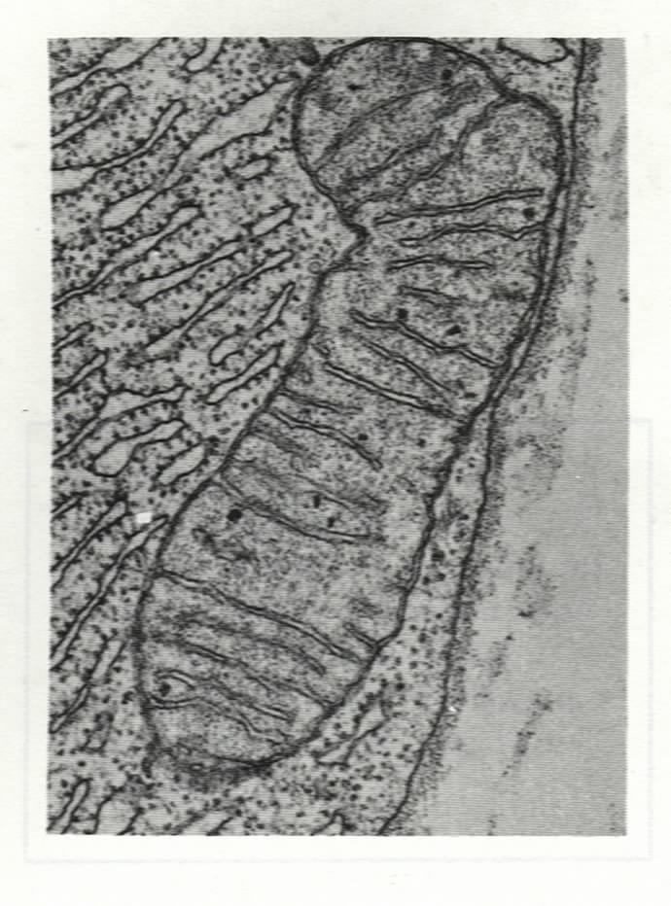
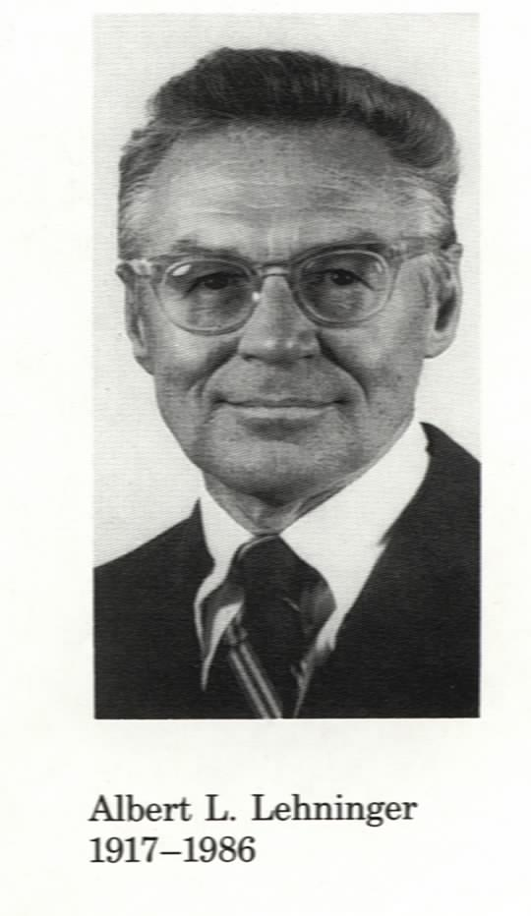
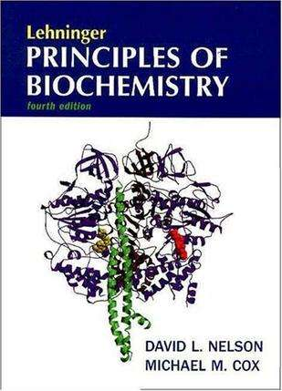

Slide 41
Activation of Fatty acid （outer membrane of mito）
Transport of fatty acyl-COA
β-oxidation：(mitochondria matrix)
Oxidation by FAD
Hydration
Oxidation by NAD⁺
Thiolysis by CoA.

Slide 42
3. Fatty acids are activated on the outer membrane of mitochondria
Fatty acids are converted to fatty acyl-CoA (a high energy compound) via a fatty-acyl-adenylate intermediate (enzyme-bound) by the action of fatty acyl-CoA synthetases (also called fatty acid thiokinase，硫激酶).

Slide 43
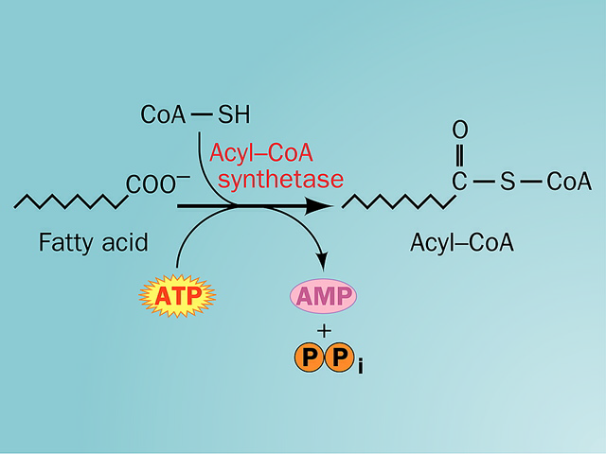

Slide 44
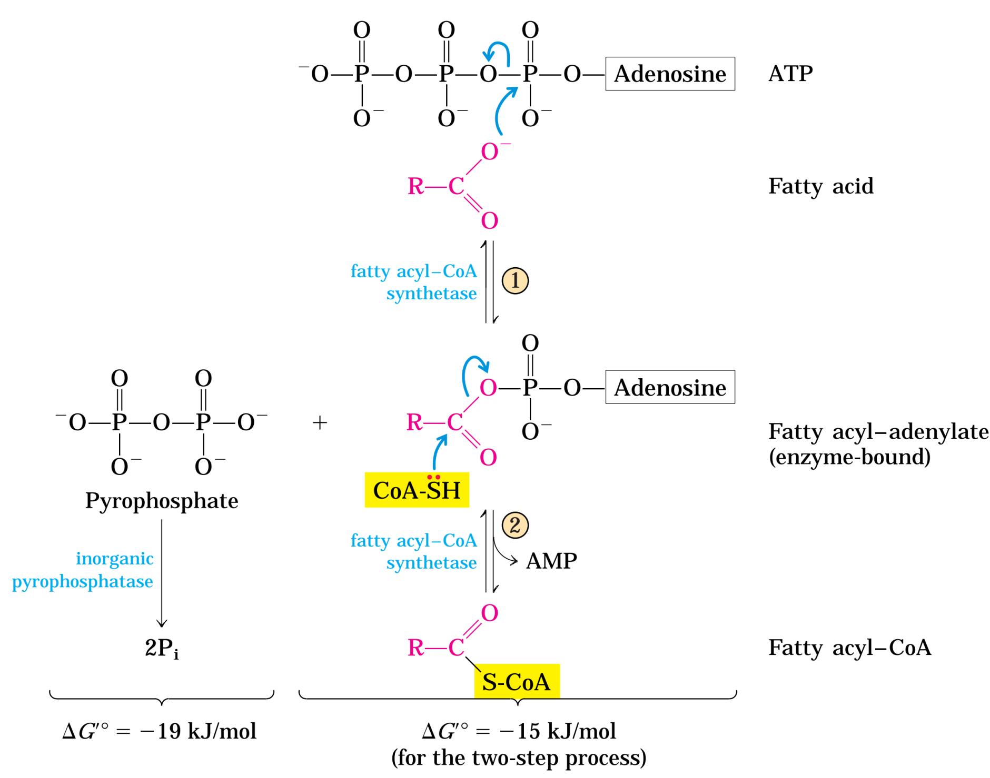
Fatty acyl-CoA is
formed from fatty
acids and coenzyme
A via a fatty acyl-
AMP intermediate

Slide 45
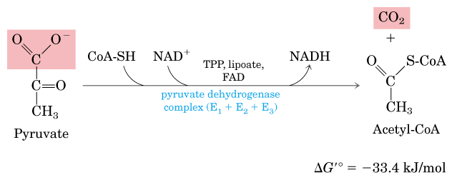
The oxidative decarboxylation of pyruvate
in mitochondria: producing acetyl-CoA and CO₂.

Slide 46
Fatty acid + CoA + ATP fatty acyl-CoA + AMP + 2Pi
The fatty acid is activated by forming a thioester link with CoA before entering the mitochondria.
The inner mitochondrial membrane is not permeable to long-chain acyl CoA derivatives.

Slide 47
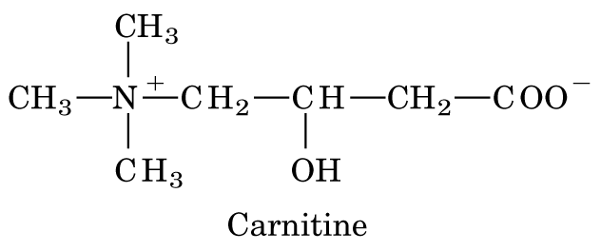
4. Activated (long chain) fatty acids are carried into the matrix by carnitine
肉碱（肉毒碱）

Slide 48
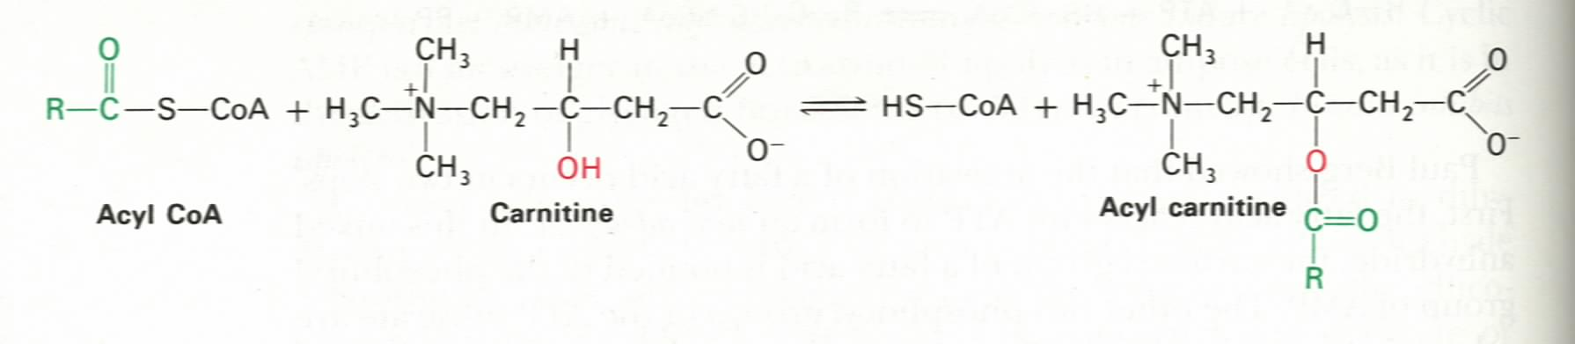
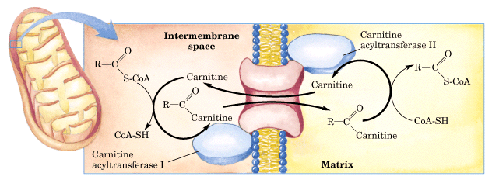

Slide 49
The fatty acyl group is attached to carnitine (肉碱） by the action of carnitine acyltransferase I located on the outer face of the inner membrane, forming fatty acyl-carnitine, leaving the CoA in the cytosol.
The acyl carnitine/carnitine transporter moves acyl-carnitine across the inner membrane of mitochondria.
The acyl group is then transferred back to CoA to form fatty acyl-CoA by the action of carnitine acyltransferase II located on the inner face of the inner membrane.

Slide 50
5. Fatty acyl-CoA is oxidized to acetyl-CoA via multiple rounds of β oxidation
The β oxidation consists of four reactions:
Oxidation by FAD
Hydration
Oxidation by NAD⁺
Thiolysis by CoA.

Slide 51
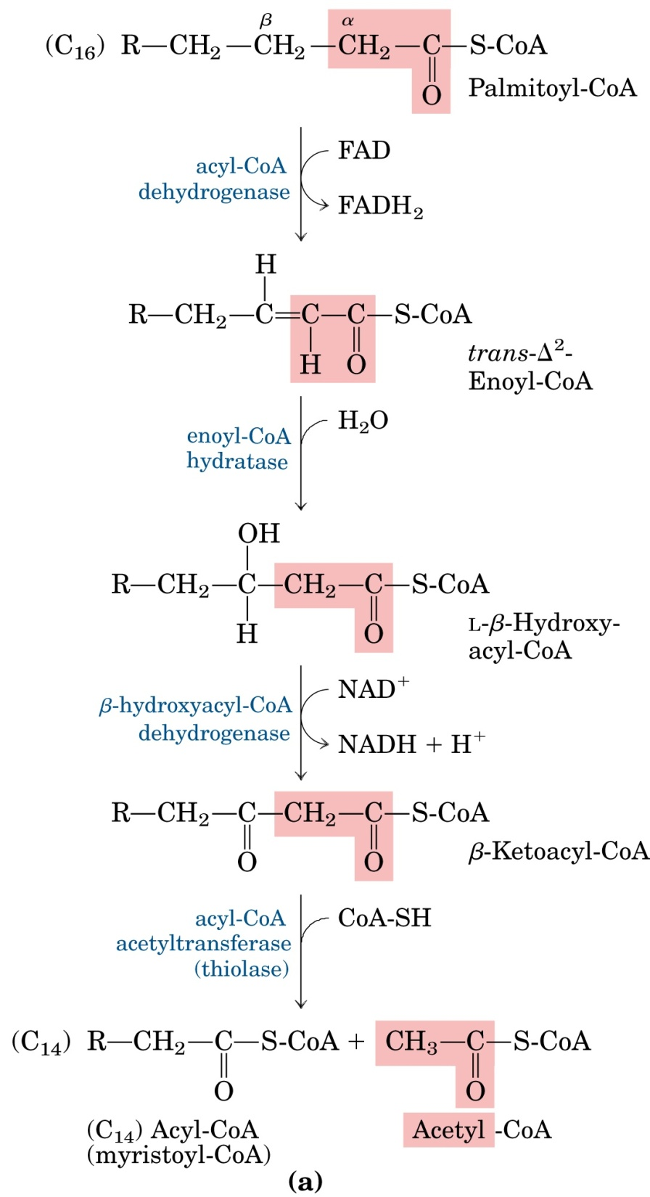
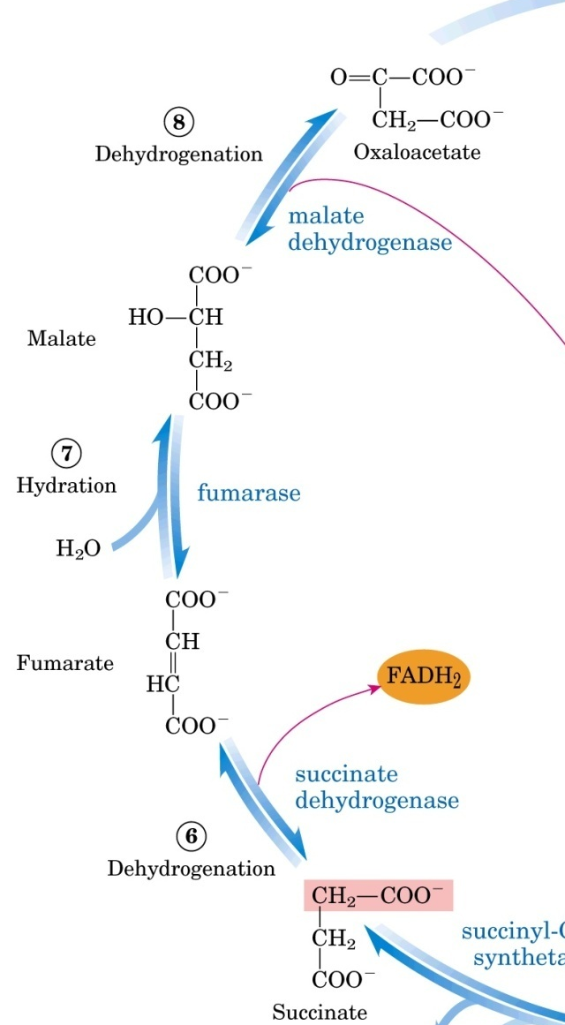
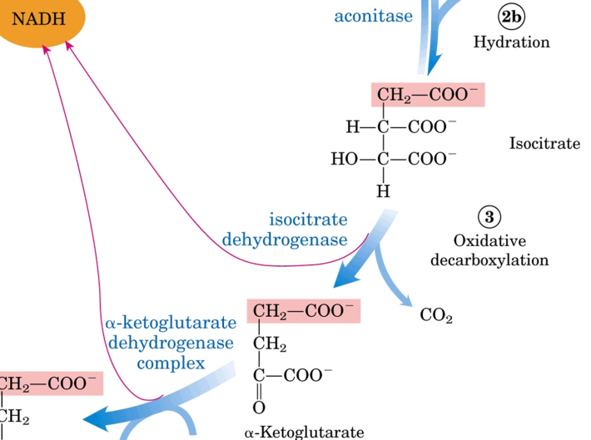

Slide 52


Slide 57
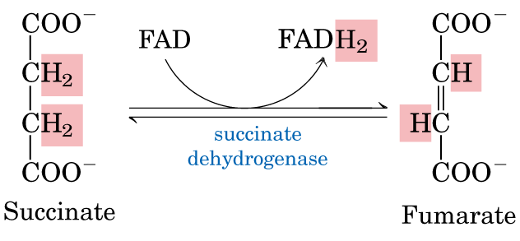
Three similar reactions between the β-oxidation and citric acid cycle

Slide 58
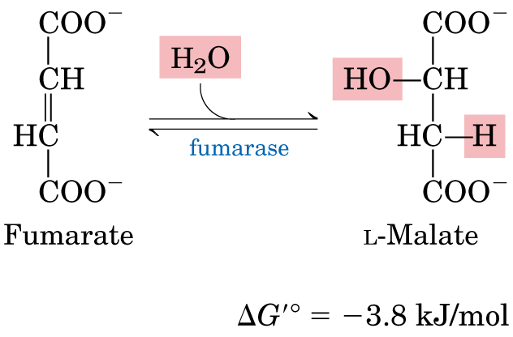

Slide 59
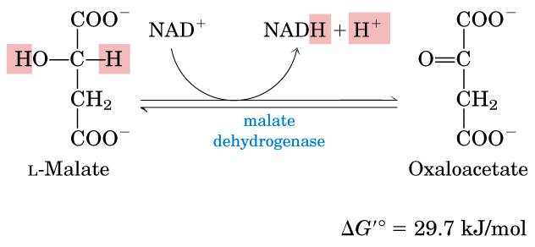

Slide 61
1. The 1st oxidation is catalyzed by the membrane-bound acyl-CoA dehydrogenase, converting acyl-CoA to trans-Δ²-enoyl-CoA with electrons collected by FAD.
2. The hydration step, catalyzed by enoyl-CoA hydratase, converts the trans-Δ²-enoyl-CoA to L-β-hydroxyacyl-CoA.
3. The second oxidation is catalyzed by L-β-hydroxyacyl-CoA dehydrogenase, converting L-β-hydroxylacyl-CoA to β-ketoacyl-CoA, with electrons collected by NAD⁺.

Slide 62
4. The acyl-CoA acetyltransferase (or commoly called thiolase) catalyzes the attack of CoA, cleaving β-ketoacyl-CoA between the α and β carbon (thiolysis), generating two acyl-CoA molecules with one entering the citric acid cycle and the other reenter the β oxidation pathway.

Slide 63
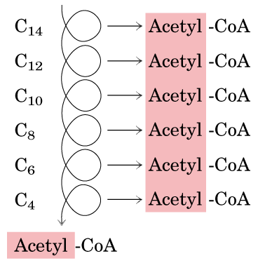
Emergy yield
C16
2

Slide 64
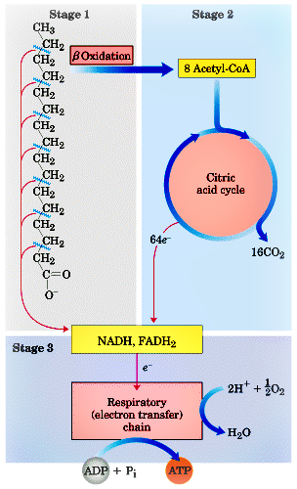

Slide 65
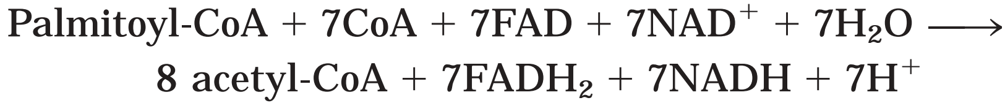
Emergy yield
The complete oxidization of each 16-carbon palmitate (to H₂O and CO₂) yields 106 ATP
(32 ATP per glucose, both having about 60% of actual energy recovery).

Slide 66
6. Oxidation of unsaturated fatty acids requires one or two auxiliary enzymes, an isomerase and a reductase
The isomerase converts a cis-Δ³ double bond to a trans-Δ² double bond.
The reductase (2,4-dienoyl-CoA reductase) converts a trans-Δ², cis-Δ⁴ structure to a trans-Δ³ structure, which will be further converted to a trans-Δ² structure by the isomerase.
NADPH is needed for the reduction (from two double bonds to one).

Slide 67
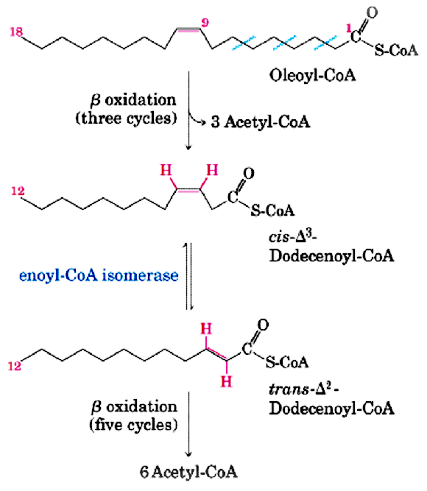
Oxidation of a
monounsaturated
fatty acid: the
enoyl-CoA
isomerase helps to
reposition the
double bond

Slide 68

Both an isomerase and
a reductase are needed
for oxidizing
polyunsaturated fatty
acids.

Slide 69


Slide 71


Slide 72
7. The oxidation of odd-chain fatty acids forms C3 propionyl-CoA
Fatty acids having an odd number of carbon atoms are also degraded by the β–oxidation pathway in the same way as those with an even number of carbon atoms.
The only difference is that in the final round the five carbon acyl CoA intermediate is cleaved into C3 propionyl CoA and acetyl CoA.

Slide 73
8. Fatty acid oxidation also occurs in peroxisomes (glyoxysomes)
Peroxisome is now recognized as the principal organelle in which fatty acids are oxidized in most cell types.
The acetyl-CoA produced in animal peroxisomes is transported into cytosol, where it is used in the synthesis of cholesterol and other metabolites.

Slide 74
The acetyl-CoA produced in plant peroxisomes/ glyoxysomes (especially in germinating seeds) is converted to succinate via the glyoxylate cycle, and then to glucose via gluconeogenesis.

Slide 75

β-oxidation of fatty
acids also occurs in
peroxisomes
catalase

Slide 76


Slide 77
9. Acetyl-CoA in liver can be converted to ketone bodies when carbohydrate supply is not optimal

Slide 78
In liver, The acetyl-CoA generated from active fatty acid oxidation can not be oxidized via the citric acid cycle and will be converted to acetoacetate （乙酰乙酸）, β-hydroxybutyrate （羟基丁酸）, and acetone （丙酮）(i.e., the ketone bodies) in mitochondria for export to other tissues.

Slide 79
For ketone body formation, first two acetyl-CoAs condense to form acetoacetyl-CoA (乙酰乙酰CoA) catalyzed by thiolase; then addition of another acetyl-CoA forms β-hydroxyl-β-methylglutaryl-CoA (β−羟－ β－甲基戊二酰CoA).
Acetoacetate can be decarboxylated to form acetone (decarboxylase) or reduced to D-β-hydroxylbutyrate (β−羟丁酸) (dehydrogenase).

Slide 80

Acety-CoA can be converted
to ketone bodies in liver.

Slide 81


Slide 83
10. Ketone bodies are converted back to acetyl-CoA in extrahepatic tissues

Slide 84

Ketone bodies are
converted to acetyl-
CoA in extrahepatic
tissues.

Slide 85
Summary
Fatty acids are activated to the acyl-CoA form and is then carried into mitochondria by carnitine with the help of two carnitine acyltranseferase isozymes (I and II) located on the outside and inside of the inner membrane.
Acyl-CoA is converted to acetyl-CoA after going through multiple rounds of the four-step (dehydrogenation, hydration, dehydrogenation and thiolysis) β-oxidation pathway.

Slide 86
Oxidative degradation of unsaturated fatty acids need two extra enzymes: an isomerase and a reductase.
The rate of β-oxidation pathway is controlled by the rate at which acyl-CoA is transported into mitochondria.
Excess acetyl-CoA (under conditions when glucose metabolism is not optimal) can be converted to ketone bodies (acetoacetate, β-hydroxylbutyrate and acetone) in the liver cells and reconverted into acetyl-CoA in extrahepatic cells.

Slide 87
Fatty Acid Synthesis
(K3)

Slide 88
1. Fatty acid synthesis takes a different pathway from its degradation
Occurs in the cytosol (chloroplasts in plants).
Acetyl-CoA provides the first two carbons, which is elongated by sequential addition of two-carbon units donated from malonyl-CoA.
Intermediates are attached to the -SH groups of an acyl carrier protein (ACP).
Notes:
88

Slide 89
NADPH is the reductant.
The enzymes are associated as a multi-enzyme complex or even being in one polypeptide chain in higher organisms (fatty acid synthase).
Elongation by the fatty acid synthase complex stops upon formation of palmitate (C₁₆), further elongation and desaturation are carried out by other enzyme systems.
unsaturated fatty acids
saturated fatty acids
desatureation

Slide 90


Slide 91
Acetyl-COA 转运
Acetyl-COA 羧化为malonyl-COA
Fatty acid synthesis：
Acetyl-COA进位KS巯基, malonyl-COA进位ACP巯基
Condensation
Reduction
Dehydration
Reduction
延长2C fatty acyl 移位至外周巯基

Slide 92
2. The acetyl groups of the mitochondrion are transported into the cytosol in the form of citrate
The acetyl-CoA molecules are made from glucose and amino acids in mitochondria.
They are shuttled into the cytosol in the form of citrate via the citrate transporter of the inner membrane.
Acetyl-CoA is regenerated by the action of ATP-dependent citrate lyase in the cytosol.
Oxaloacetate is shuttled back into the mitochondria as malate or pyruvate.

Slide 93


Slide 94
3. Malonyl-CoA is formed from acetyl-CoA and bicarbonate
Salih Wakil discovered that HCO₃⁻ is required for fatty acid synthesis.
Acetyl-CoA carboxylase catalyzes this carboxylation reaction.
The enzyme has three functional parts: a biotin carrier protein; an ATP-dependent biotin carboxylase; and a transcarboxylase.

Slide 95


维生素B7 生物素
biotin
carboxylase
Trans-
carboxylase
biotin carboxyl-carrier protein BCCP

Slide 96


Slide 97


Slide 98
4. The acetyl and malonyl groups are first transferred to two –SH groups of the fatty acid synthase complex
The acetyl group of acetyl-CoA is first transferred to the –SH group of a Cys residue on the β-ketoacyl-ACP synthase (KS) in a reaction catalyzed by acetyl-CoA-ACP transacetylase (AT).
The malonyl group is transferred from malonyl-CoA to the –SH group of the acyl carrier protein (ACP) catalyzed by malonyl-CoA-ACP transacetylase (MT).

Slide 99


Slide 100


Slide 101

The acyl carrier protein (ACP) is very similar to CoA (thus can be regarded as “macro CoA”)

Slide 102


B5

Slide 103


Slide 104


Slide 105
4. Fatty acids are synthesized by a repeating four-step reaction sequence
step 1
Condensation of acetyl-ACP and malonyl-ACP to form acetoacetyl-ACP, releasing free ACP and CO₂.

Slide 106


Slide 107
Step 2
Reduction of acetoacetyl-ACP to
form hydroxybutyryl-ACP, using
NADPH as reductant.

Slide 108


Slide 109
Step 3
dehydration of hydroxybutyryl-ACP to produce crotonyl-ACP.

Slide 110


Slide 111
Step 4
Reduction of crotonyl-ACP by a second NADPH molecule to give butyryl-ACP .

Slide 112


Slide 113


Slide 114


Slide 117


Slide 118


Slide 119


Slide 120


Slide 121


Slide 122


Slide 123


Slide 124


Slide 125
5. Palmitate can be further elongated and desaturated in smooth ER
Palmitoyl-CoA can be further elongated by the fatty acid elongation system present mainly in the smooth endoplasmic reticulum （ER）, with two-carbon units also donated by malonyl-CoA.
Stearoyl-CoA (硬脂酰）can be desaturated between C-9 and C-10 to produce oleate（油酸）, 18:1( Δ⁹).

Slide 126
The double bonds are introduced by the catalysis of fatty acyl-CoA desaturase, where both the fatty acyl group and NADPH are oxidized by O₂.
Linoleate (亚油酸) and linolenate （亚麻酸）cannot be synthesized by mammals and are therefore termed essential fatty acids as they have to be ingested in the diet.

Slide 127

Palmitate is the
Precursor for the
biosynthesis of
other fatty acids

Slide 128

Fatty acyl-CoA is desaturated (oxidized)
by O₂ and NADPH.

Slide 129

Oleate can be
desaturated on
Phosphatidylcholine

Slide 130
6. Essential fatty acids
The polyunsaturated fatty acids linoleate and linolenate cannot be synthesized by mammals and are therefore termed essential fatty acids as they have to be ingested in the diet.

Slide 131
7. Newly synthesized fatty acids have mainly two alternative fates in cells
Fate I: be incorporated into triacylglycerols as a form to store metabolic energy in long terms.
Fate II: be incorporated into membrane phospholipids (during rapid growth).

Slide 132


Slide 133



Slide 134
8. The rate of fatty acid biosynthesis is controlled by acetyl-CoA carboxylase
Acetyl-CoA carboxylase is regulated by allosteric effectors and reversible phosphorylation.

Slide 135

Citrate partially activate the phosphorylated acetyl-CoA carboxylase

Slide 136
Acetyl-CoA carboxylase, catalyzing the committing and rate-limiting step of fatty acid synthesis, is allosterically inhibited by palmitoyl-CoA and activated by citrate.
Glucagon and epinephrine inhibit protein phosphatase 2A, thus keeping acetyl CoA carboxylase in the inactive form and blocking fatty acid synthesis. Insulin stimulates acetyl CoA carboxylase.

Slide 137
4. Insulin stimulates conversion of dietary carbohydrates/proteins into fat
Diabetes patients due to lack of insulin would neither be able to use glucose properly, nor to synthesize fatty acids from carbohydrates and amino acids.
They show increased rates of fatty acid oxidation and ketone body formation, thus losing weight.

Slide 138
Summary
Fatty acid biosynthesis takes a different pathway from the reverse of its degradation and takes place in different cellular compartments.
The aceytl-CoA units are transported out of mitochondrial matrix as citrate.

Slide 139
Acetyl-CoA carboxylase catalyzes the rate-limiting step of fatty acid synthesis and is highly regulated by allosteric and covalent modifications.
Palmitate, the usual final product of fatty acid synthesis, can be further elongated and desaturated in sER.

Slide 140
Metabolism of Triacylglycerols K4

Slide 141
1. Newly synthesized fatty acids have mainly two alternative fates in cells
Fate I: be incorporated into triacylglycerols as a form to store metabolic energy in long terms.
Fate II: be incorporated into membrane phospholipids (during rapid growth).

Slide 142


Slide 143


Slide 144


Slide 145



Slide 146


Slide 147
2. Triacylglycerols are synthesized from glycerol 3-phosphate and acyl CoAs
L-glycerol 3-phosphate is derived from either glycerol or dihydroxyacetone phosphate.
Acyl CoAs are added on to glycerol 3-phosphate to form phosphatidic acid.
A phosphatidic acid is converted to a triacylglycerol via a dephosphorylation reaction (catalyzed by phosphatidic acid phosphatase) and a acyl transferring reaction.

Slide 148


Slide 149


Slide 150


Slide 151



Slide 152
3. Breakdown of triacylglycerols
The fatty acids in triacylglycerols are released from the glycerol backbone by the action of lipases.
The free fatty acids can then degraded by β–oxidatin to produce energy.
The glycerol is converted into dihydroxyacetone phosphate which enters glycolysis.

Slide 153


Slide 154


Slide 155


Slide 156
4. Insulin stimulates conversion of dietary carbohydrates/proteins into fat
Diabetes patients due to lack of insulin would neither be able to use glucose properly, nor to synthesize fatty acids from carbohydrates and amino acids.
They show increased rates of fatty acid oxidation and ketone body formation, thus losing weight.

Slide 157
胰岛素对糖代谢的作用，主要是刺激糖原和脂肪酸的合成。
糖尿病的发生，直接原因是血中胰岛素含量不足。
患者的肝脏往往产生过量的葡萄糖，由于缺少胰岛素，葡萄糖不能正常地进入细胞。又因胰高血糖素的浓度高于胰岛素的浓度，一方面导致肝脏中－FBP的浓度下降，使糖酵解受到抑制，又刺激了葡萄糖异生，另一方面又加速了糖原的降解。这些过程都促使肝脏产生过量的葡萄糖进入血液。糖尿病患者由于糖代谢紊乱进而使脂类代谢和蛋白质代谢都受到损害。
I型——insulin dependent——儿童
II型——noninsulin-dependent——成人

Slide 158


Slide 159


Slide 160


Slide 161


Slide 162


Slide 163


Slide 164
END
Thank you

